Slide 1
Commercial Content Taxonomy for Life Sciences

Slide 2
Commercial Content Taxonomy for Life Sciences
Education materials available for customers to use
These slides have been designed for you to use as educational materials for discussions about the Commercial Content Taxonomy for Life Sciences in your organization.
You will find details on:
Why there is a new Commercial Content Taxonomy for Life Sciences?
What are the benefits for your organization and for the industry more widely?
What it is?
How to adopt it?
You can adapt these template slides and share with your colleagues.

Slide 3
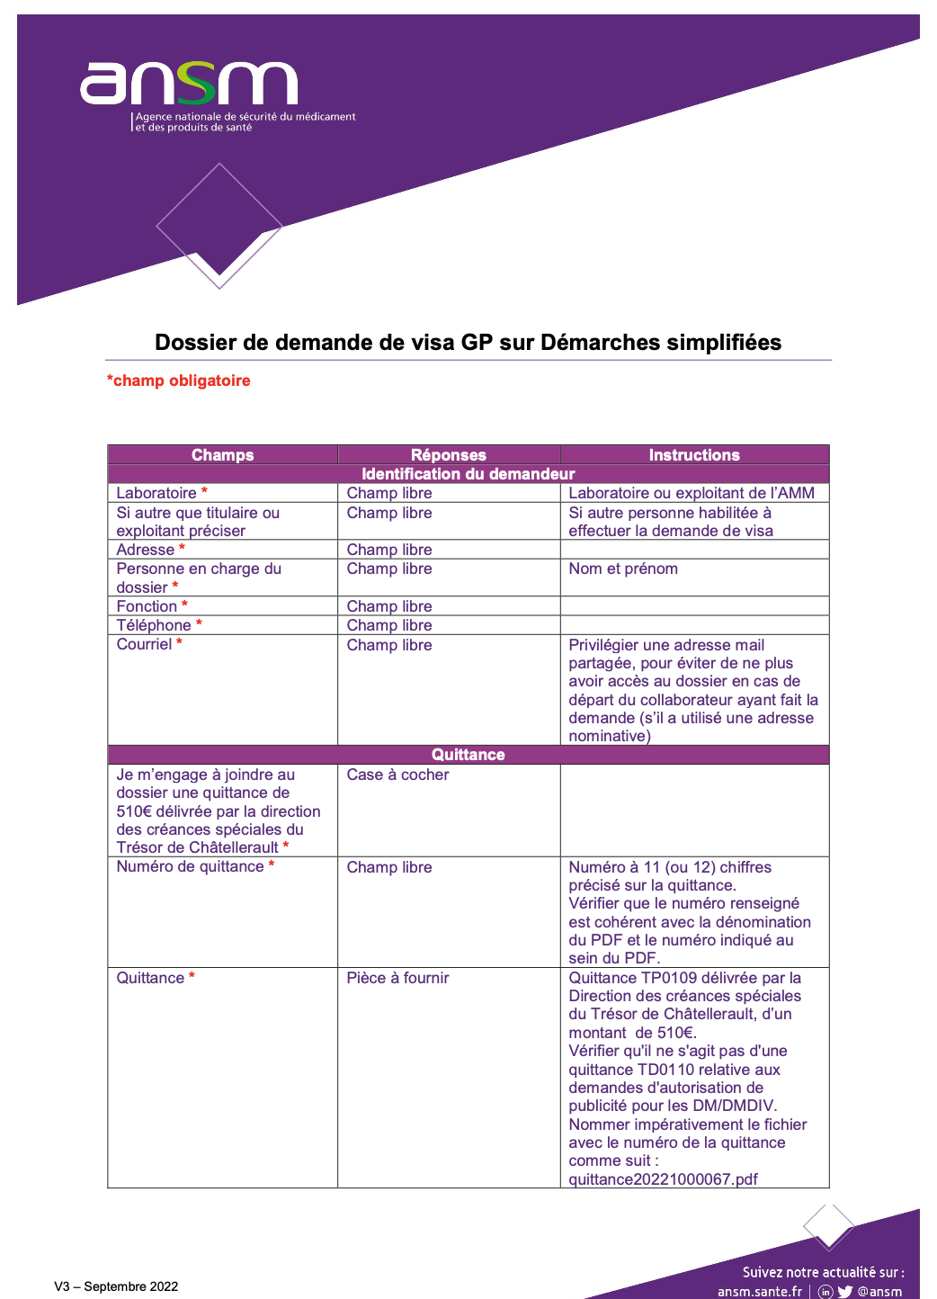
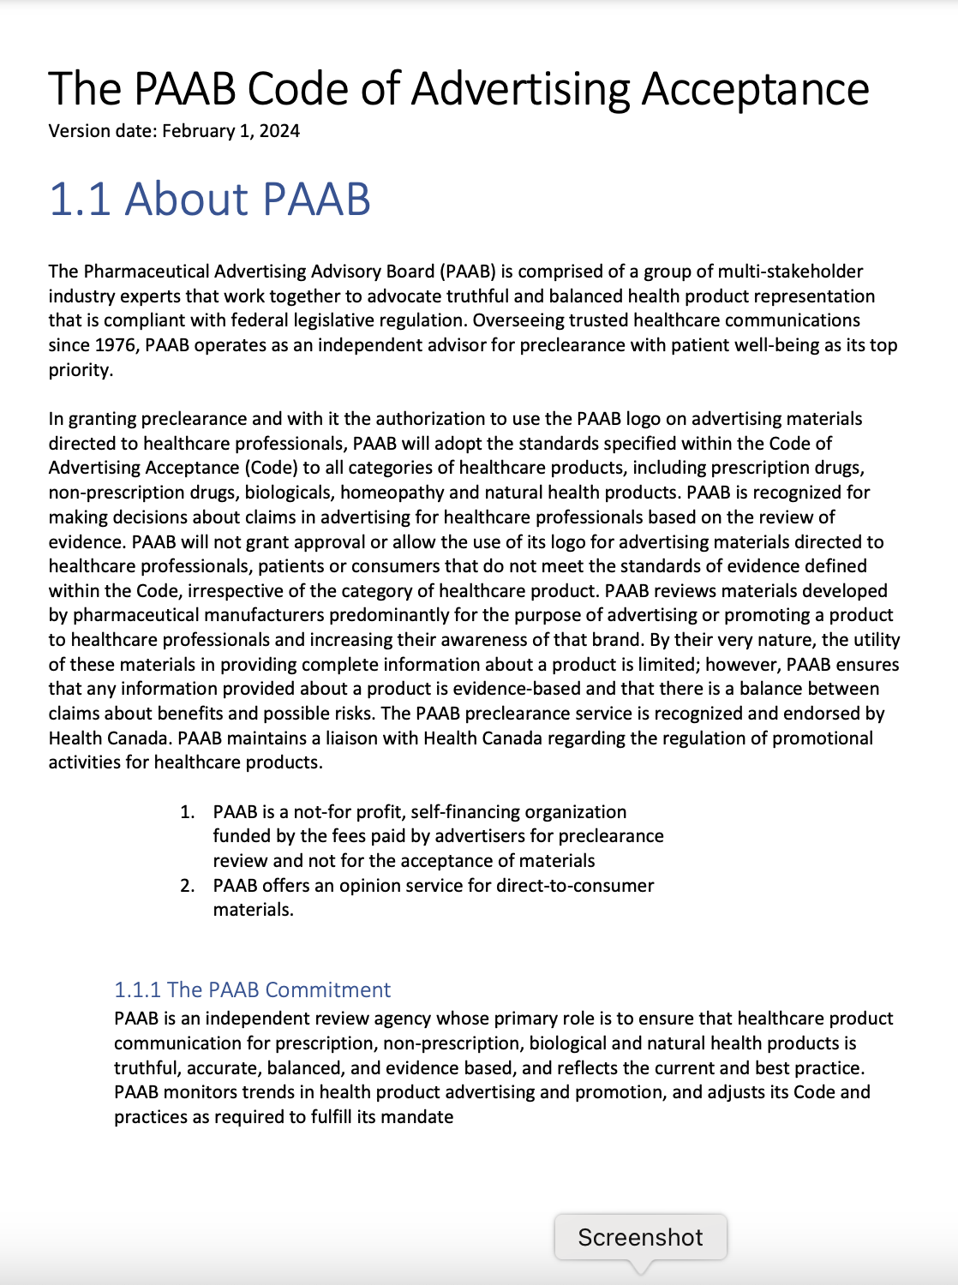
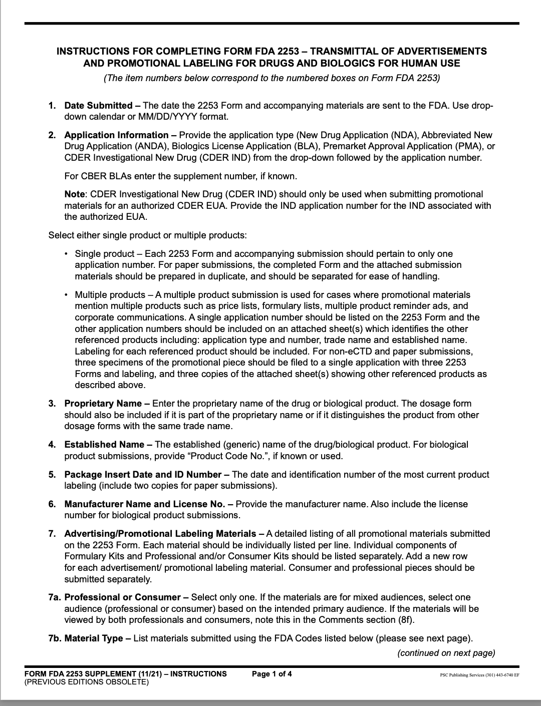
Why Does the Industry Need a Taxonomy Standard?
Inconsistent
300k+
content types maintained by the industry
Duplicative
Hard to understand

Slide 4
Commercial Content Taxonomy for Life Sciences
A global, industry-specific taxonomy created and published by Veeva, used in Vault PromoMats, available to all
Innovation Enabled by Standardization
Easier for Integrations
Simpler and Less Expensive to Maintain

Slide 5
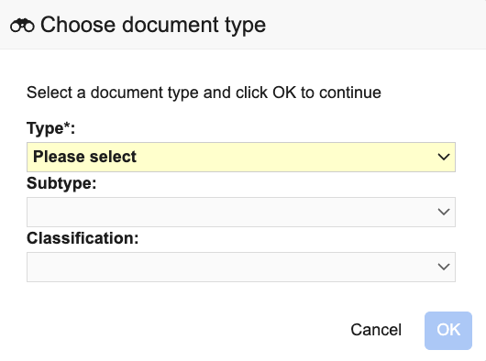
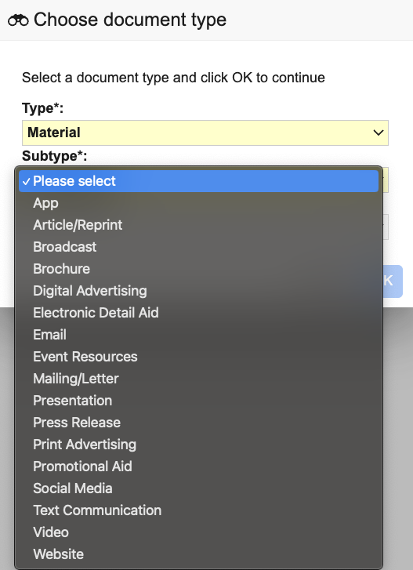
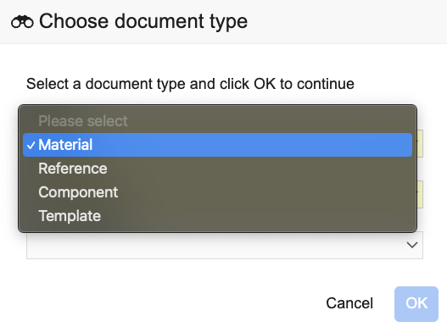
Adopt the Commercial Content Taxonomy for Life Sciences
Available in Vault PromoMats, as inactive, in 24R2

Slide 6
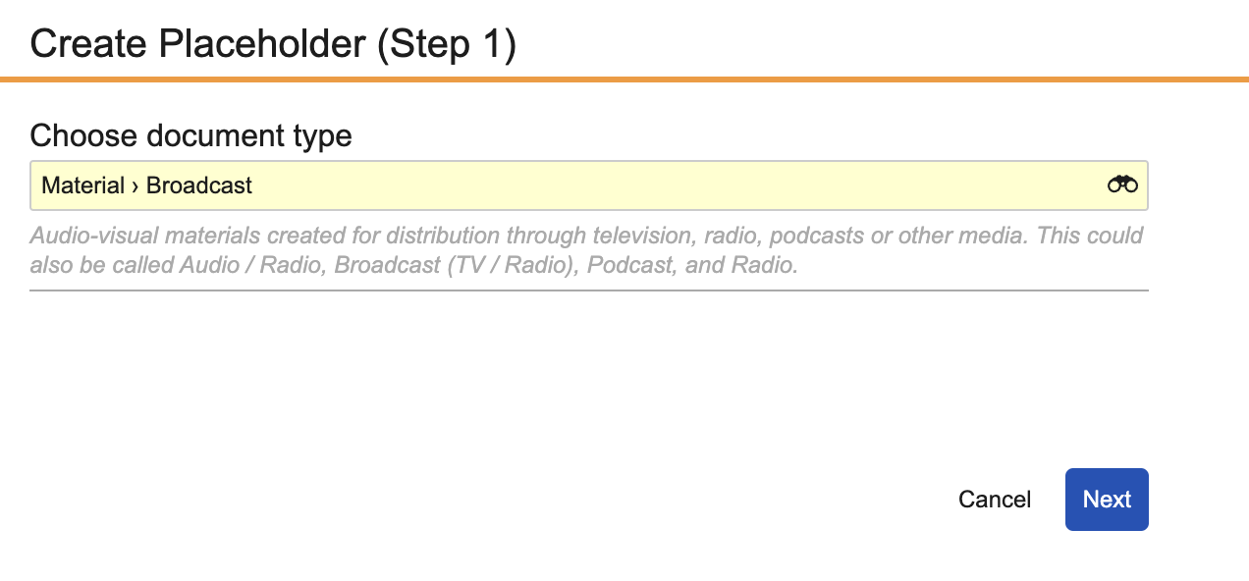
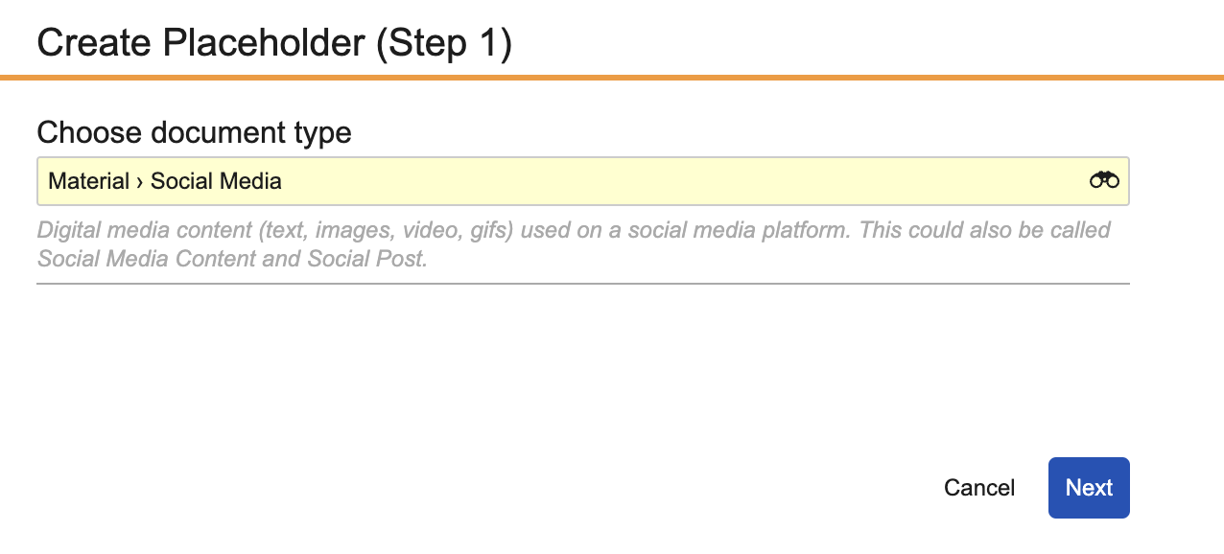
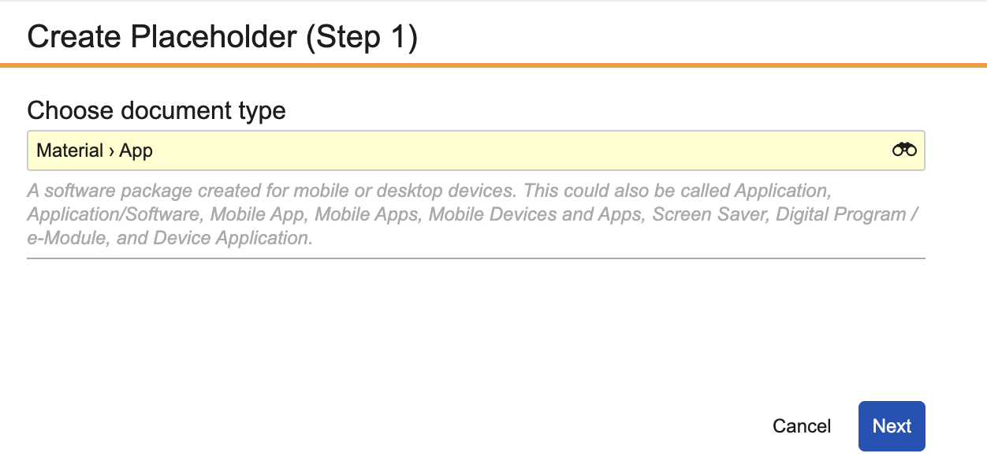
Adopt the Commercial Content Taxonomy for Life Sciences
Available in Vault PromoMats, as inactive, in 24R2
Every document type in the new taxonomy has a description which includes synonyms which were gathered from the main variations seen across the industry.

Slide 7
Adopt the Commercial Content Taxonomy for Life Sciences
How will the industry adopt? How is Veeva helping?
Available in Vault PromoMats for all customers from August 2024
4-step taxonomy adoption program with complete methodology for fast and efficient implementation from Veeva Services
Industry Advisory Group established July 2024 to shape and drive industry adoption

Slide 8
4-Step Taxonomy Adoption Program
A complete, fast and efficient implementation with Veeva Services
Complete & Pre-built
The Veeva methodology addresses all aspects of configuration, business processes analysis, and customer’s technology ecosystem with clear recommendations for best practices.
Taxonomy Adoption Program
Automation Tools
Specialized tools to automate tasks, and significantly reduce time and cost.
1. Assessment
2. Configuration
Expert Team
Our dedicated team has extensive experience implementing all aspects of taxonomy changes.
3. Re-classification
4. End-user enablement
Notes:
Ani

Slide 9
4-Step Taxonomy Adoption Program
A complete, fast and efficient implementation with Veeva Services
ASSESSMENT
CONFIGURATION
RECLASSIFICATION
END-USER ENABLEMENT
Expert Led Analysis
Configuration and business process analyses, including mapping and impact assessments.
Document types
Industry Standard: Taxonomy configuration
Core Vault
Data Driven Approach: Core Vault re-configuration based on configuration analysis
Integrations
Connected: Reconfiguring integrations to work with standard taxonomy (if applicable)
Complete
Reclassifying existing content to the standard taxonomy
Equipped for success
Leading change management activities, including communication, education and analytics to ensure a seamless shift
2–6 months
Notes:
The implementation timeline typically ranges from two months to six months and is always right-sized for each customer through scoping.
The time required can vary based on Vault complexity, integrations, and available content.

Slide 10
Projected Industry Adoption of Taxonomy
Establish & publish
(new PromoMats)
Adopt early migrators
Adopt early majority
Adopt late majority
Standard way of working
2024
2025
2026
2028
2030

Slide 11
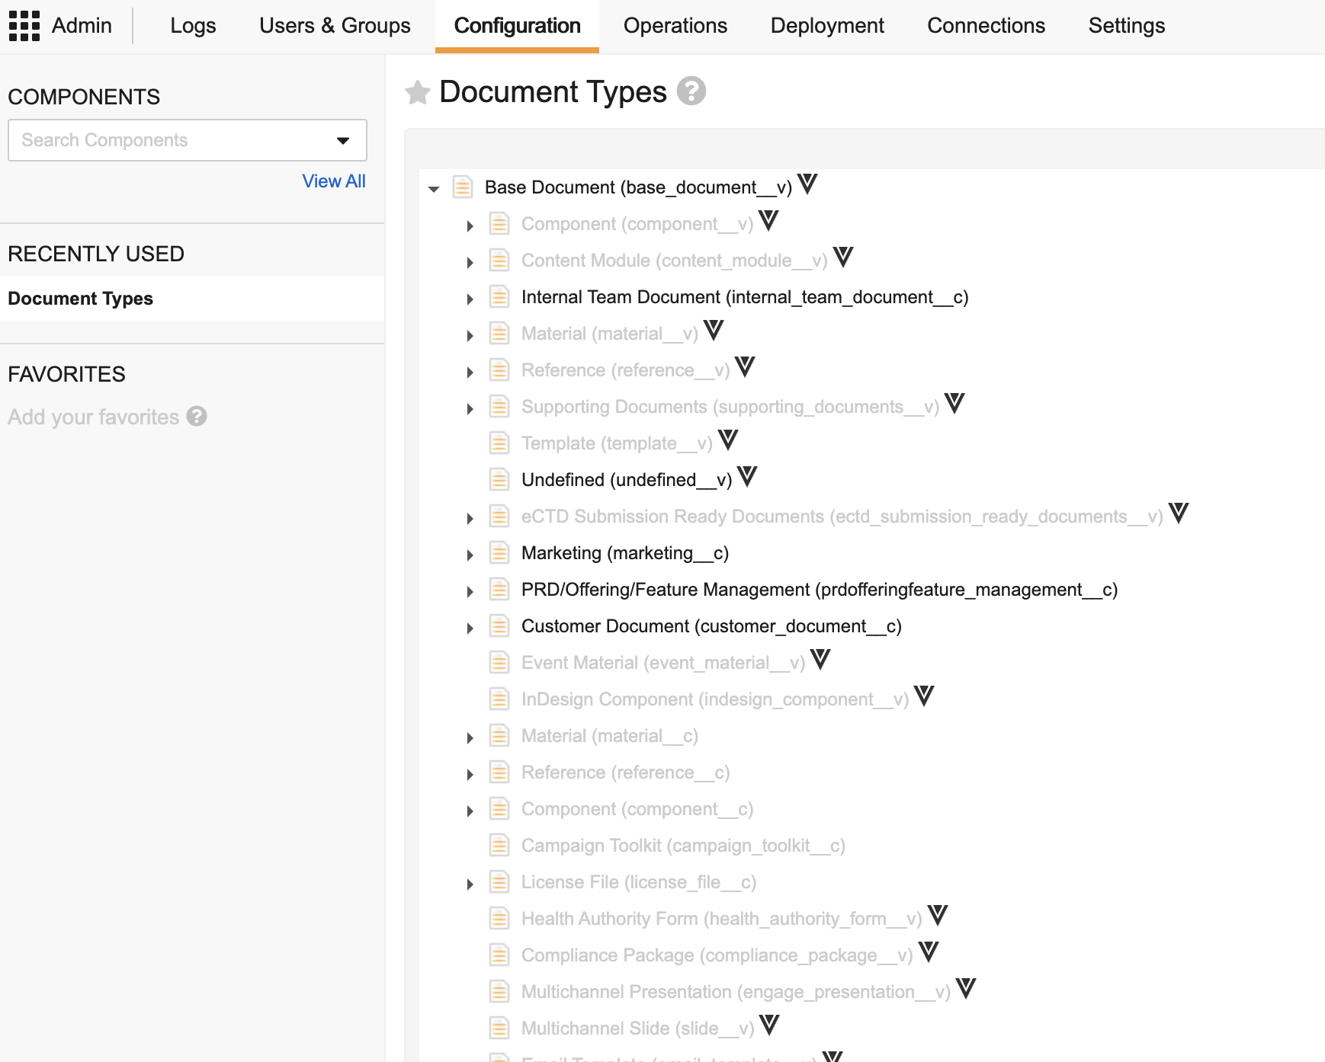
Your Current Taxonomy in Vault PromoMats
Unlock insights by engaging your Vault Admins in a quick taxonomy check-up
Do a quick assessment of Taxonomy complexity and potential for standardization by looking at:
Number of Document Types
Number of Subtypes
Number of Classifications
Are clear descriptions available for all Types, Subtypes, and Classifications?
CONTACT YOUR VEEVA TEAM TO START A DETAILED ASSESSMENT OF YOUR VAULT PROMOMATS
Vault Admins can see the complexity of current taxonomy in your configuration in the “Document Types” area in Admin.

Slide 12
For More Information, We Are Here to Help
veeva.com
More information, including a white paper and the Taxonomy
Your Veeva Account Partner
How to adopt the Taxonomy in your organization

